Slide 1

What is customer retention?
“It is not a tool it is an art!”
Problem Statement: To analyse customer retention and customer activation based on data given.
Let’s, first understand what customer retention means and its benefits.

Slide 2
Customer Retention(CR):
“It refers to the activities and actions companies and organizations take to reduce the number of customer defections.”
In other words customer retention means,
“to maintain existing customers”
This happens if there is a positive relationship between a company and its customers.

Slide 3
What are the benefits of CR?
Retained customers tend to buy other services from same company.
Retained customers are known to be less price/cost sensitive.
Positive Word of Mouth – Free marketing 24*7
The probability of selling to an existing customer is 60-70%
The probability of selling to a new prospect is 5-20%
Declined migration rates
Remember it is more expensive to acquire a mew customer than to retain an old one.

Slide 4
EDA AND VISUALIZATION:
As, the dataset given is of categorical type or object type and have a few number of unique classes count-plot has been used.
First, null values or missing values were check if there one any.
One column of the dataset had some typos which were replaced.
After no missing values were found, data visualization began.
Why count-plot?
- Because count-plot gives count of the different classes which helps in understanding the opinion as response or feedback given by the customers.
Count-plot gave us insight of customers opinion which might provide help in understanding the customer behaviour.

Slide 5
While plotting the count-plot for different data values, several classification were given, like using gender of customers or age group of customers or their preferred payment method etc.
This gives a kind of relationship between customers and opinion and to which group they belong to.
This might help in understanding the masses of same groups effectively.

Slide 6
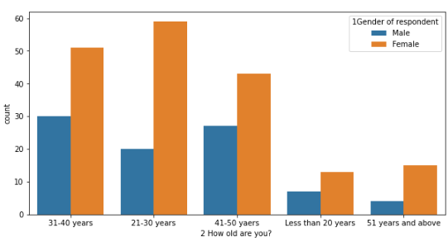
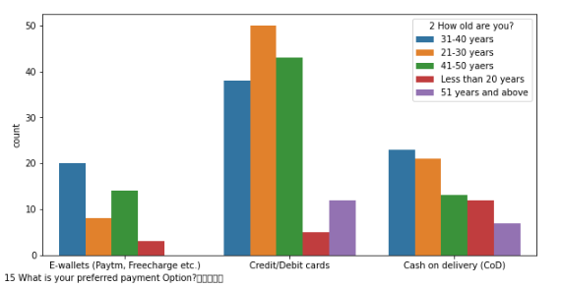
Age groups of the respondent →
Preferred payment options →

Slide 7
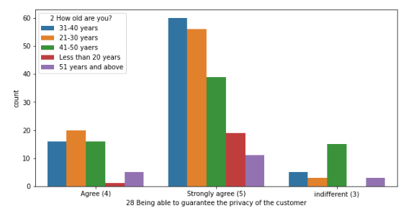
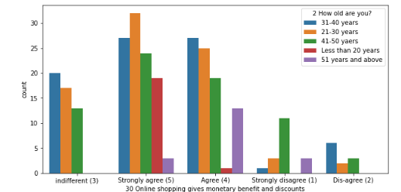
Guaranteeing privacy of the customer →
Online shopping is beneficial →

Slide 8
ANALYSIS:
So, it could be seen that both utilitarian value and hedonistic values are a must for customer retention.
While the basic needs of a customer for online shopping includes trust bond with e-retailer, easy shopping and payment process, monetary and other benefits other complexities like enhancement of social status, gratification, enjoyment coming from online shopping, adventure in online shopping are also important aspects for customer retention as they are crucial in determining customer behaviour.
Knowing your customer is also one of the key for customer activation.
The better the user experience i.e. the more pleasurable online shopping can be the more customers won’t leave.
For, the given dataset these all aspects were fulfilling most customers, so it can be assumed that the customer retention rate for e-retailer like amazon.in , flipkart.com is good.

Slide 9

Conclusion:
Getting a customer in the door is the first step, but customer turnover, or “churn rate,” can be a quiet killer of a company’s potential.
Focusing on customer retention can increase revenue over an 18-24 months period by as much as 80%, reduce customer acquisition costs by 30%, and increase total customers by 1.5 times.
A high or great customer retention rate can be achieved by:
Finding out what customers want and what cause them to stay or leave.
Proactively collecting and promoting customer feedback because who better to ask for feedback than customer himself and then analyzing these feedbacks for insights.
Keep asking, listening, analyzing and thus improving.

